Slide 1

DATA MINING PROJECT:
A TECHNICAL REVIEW
ON
TEXT RECOGNITION FROM IMAGES
Presenters~ Rohit Kumar Behera (B118049) & Samprita Sahoo (B118052)

Slide 2
Optical Character Recognition:
Text Recognition from images is an active research area which attempts to develop a computer application with the ability to automatically read texts from images.
However due to font characteristics of the characters in paper documents and quality of images,computer might be unable to recognise them while reading.
Thus there is a need of character recognition mechanisms to perform document image analysis to transform document in paper format to electronic format.
These mechanisms are referred to as Optical Character Recognition or OCR.
Link to Paper

Slide 3
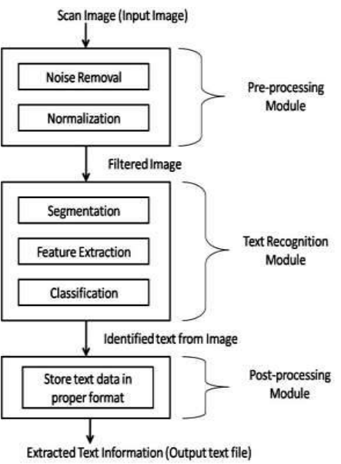
Flow Chart:
Pre-processing Module
Text Recognition Module
Post-processing Module

Slide 4
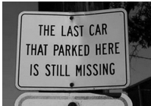
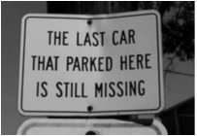
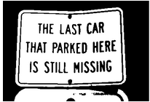
Preprocessing:
Resizing of Image
Reducing Noise in Image
Thresholding
Padding
Skewness Detection

Slide 5
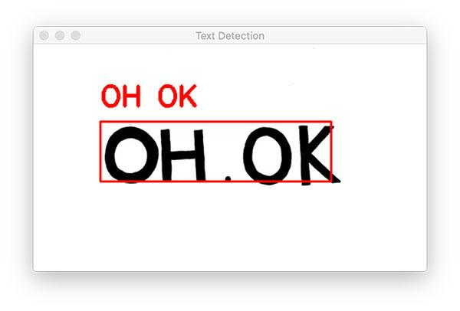
Text Recognition Module:
Canny Edge Detection
Contour Detection
Applying bounding boxes
Deskewing the Image
Wrap perspective

Slide 6
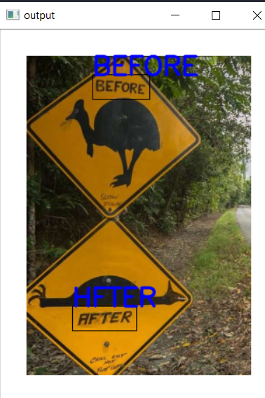
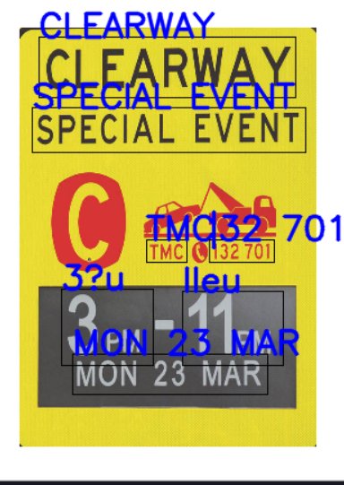
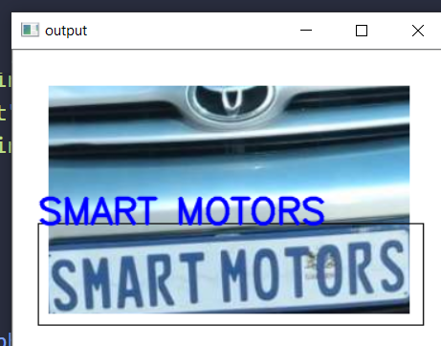
Post Processing Module:
The extracted text from image is printed on the terminal.
In case of scene detection, we are producing bounding boxes on the image itself around the text to be detected and the extracted text is displayed there itself.

Slide 7
Workflow:
USER INTERFACE
Browse the image from local folder
Scene Detection
Document Scanner
2D Image Scanner
Preprocessing
Text Recognition Model
Post Processing Model

Slide 8
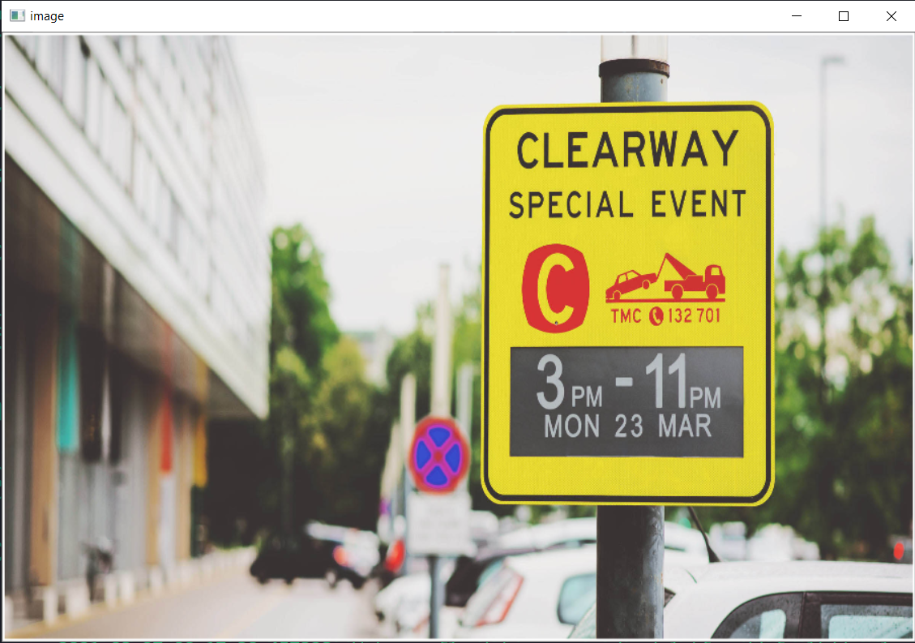
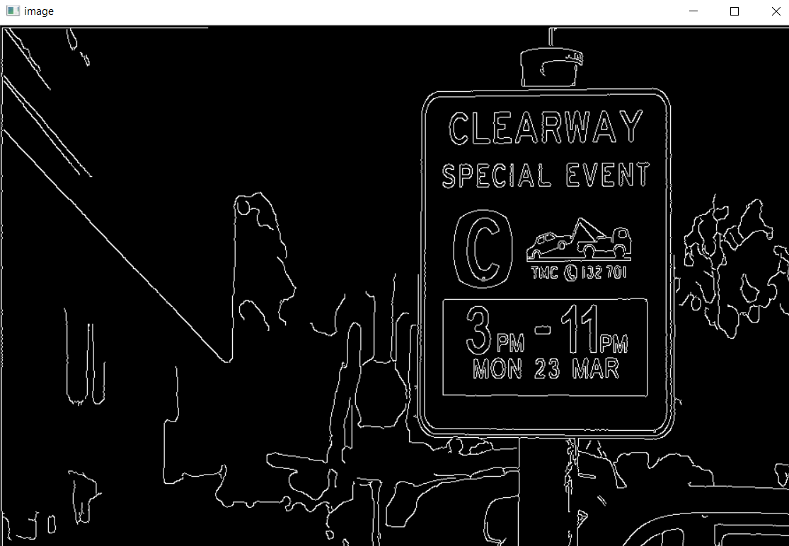
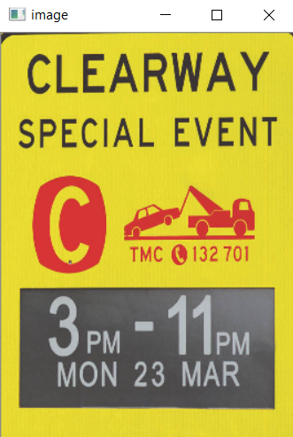
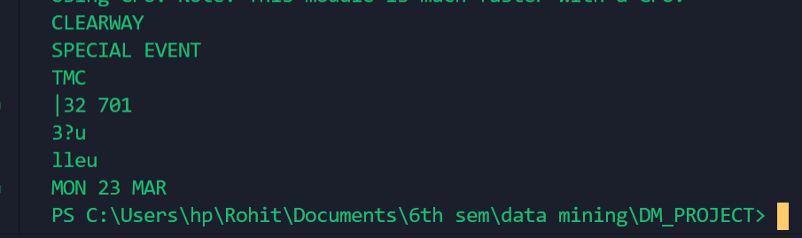
Results:

Slide 9
Conclusion:
Some changes we would like to bring in our project which includes improving the accuracy of classification model, extending the model to get dynamic feed method to capture live photo and recognise text in it. This way we can make our text recognition model more effective and useful for several purposes.

Slide 10

Thank You!

